Slide 1
Day 6 – Git and Github Crash Course

Slide 2
Intro
Git is a popular, fast, scalable, free and open-source version control system
Version control system is a tools that helps to track changes in code

Slide 3
Two way to use git
Tracking history
Collaboration

Slide 4
Github
Website that allows developer to store and manage their code using git.
Folder (Repository)

Slide 5
Working with Github
Create a github account.
Create a new repo
Make our first commit
Notes:
Engagement and marriage

Slide 6
Setting up Git
Vscode
Windows (Git bash)
Mac (terminal)
Git-scm.com

Slide 7
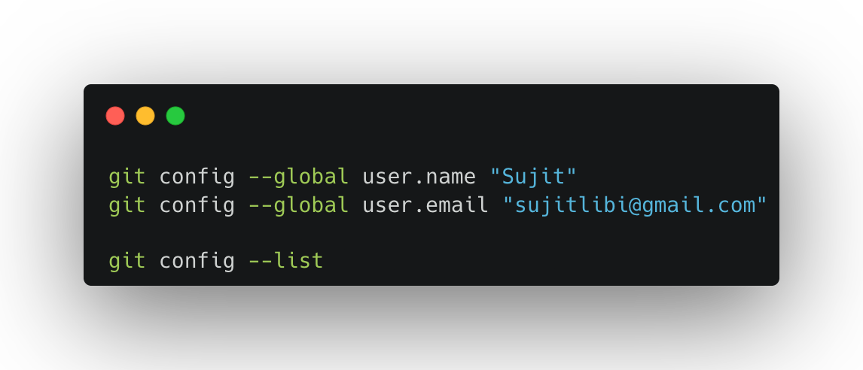
Configuration Git

Slide 8
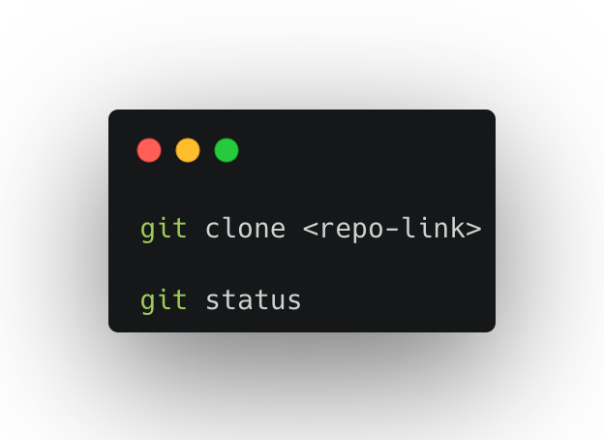
Clone and Status
Clone: cloning a repo on our local machine
Status: display status of the code
Types of Status
untracked: new files that git does not know yet or track
Modified: changed
Staged: file is ready to be committed

Slide 9
add, commit and push
Add: adds new or changed files in your working directory to the git staging area
Commit: it is the record of change
Push: upload local repo content to remote repo

Slide 10
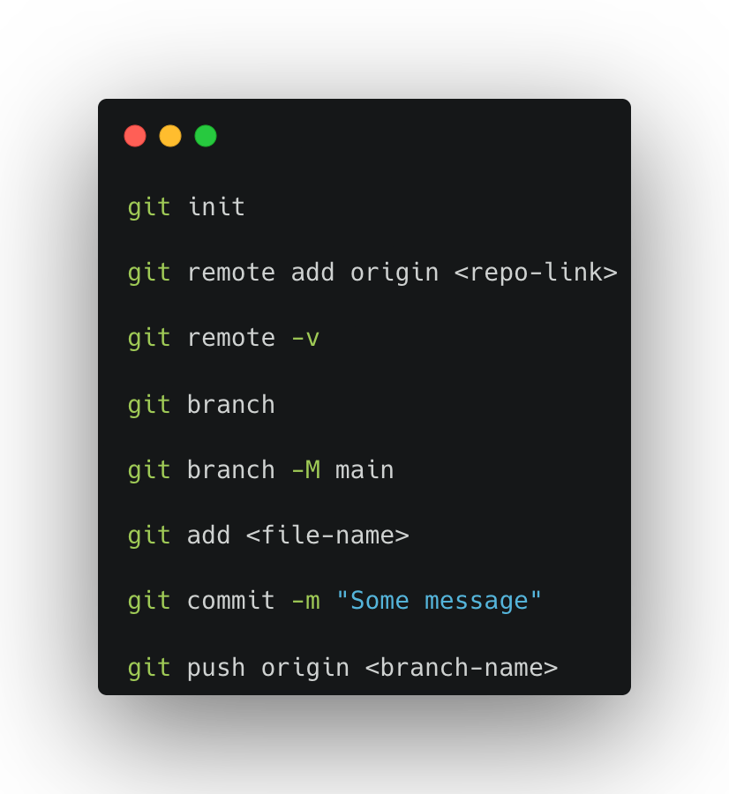
Init
User to create a new git repo

Slide 11
Workflow (local git)
Github repo => clone => changes => add => commit => push

Slide 12

Branch

Slide 13
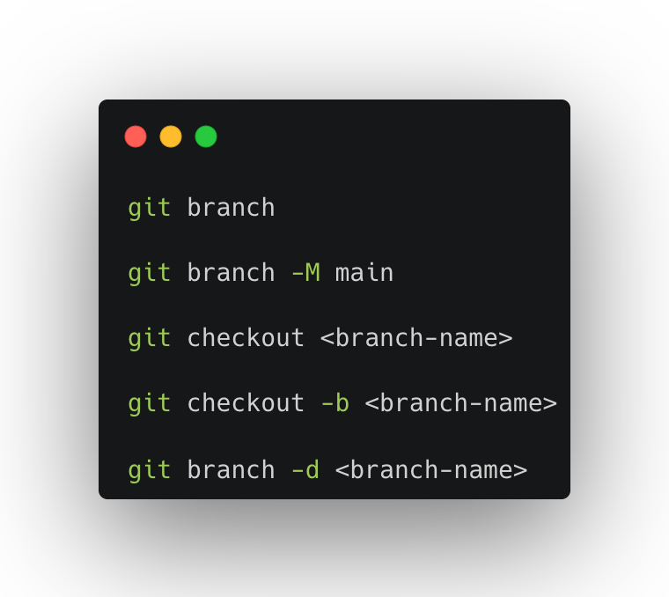
Branch Command

Slide 14
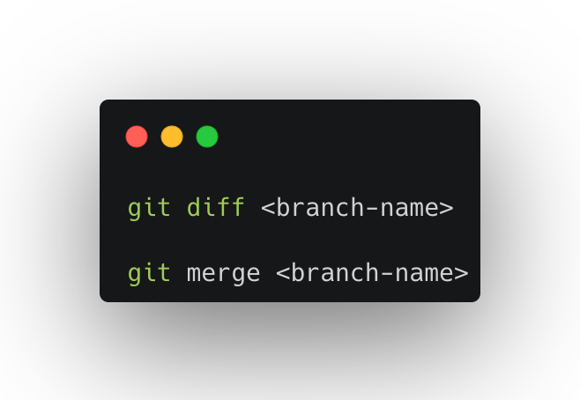
Merging Code
Way 1:
Way 2:
Create PR through Github / GitLab

Slide 15
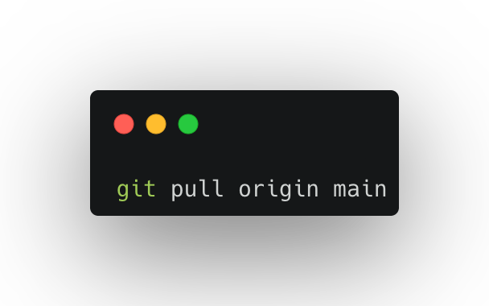
Pull request
It lets you tell others about changes you’ve pushed to a branch in a repo on Github.

Slide 16
Merge Conflict
An event that take place when git is unable to automatically resolve difference in code between two commits.

Slide 17
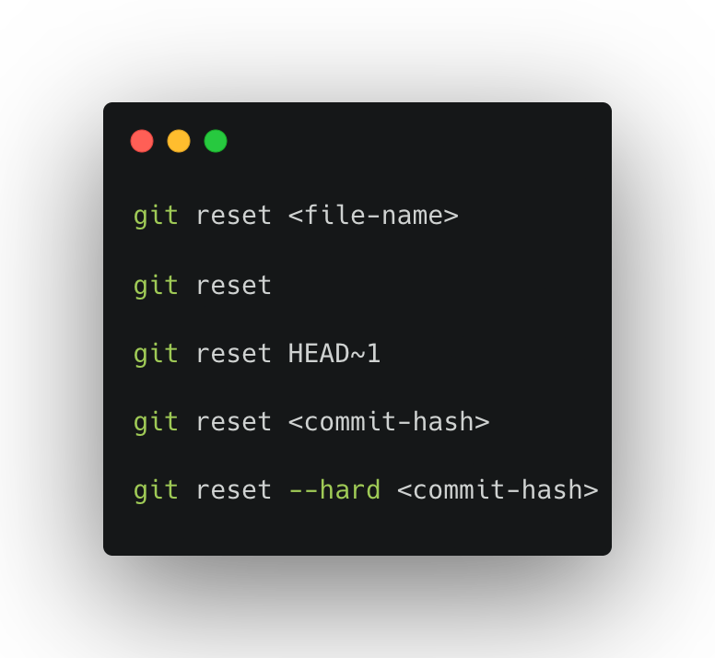
Undoing Changes:
Case 1: Staged Changes
Case 2: Committed changes (for one commit back)
Case 3: Multiple committed changes

Slide 18
Fork
A fork is a new repo that shares code and visibility setting use the rough copy of original repo.

Slide 19
Extra Resouces:
https://docs.chaicode.com/
https://www.youtube.com/watch?v=q8EevlEpQ2A&t=1893s

Slide 20
Feedback
What went well?
What went wrong?
What did you learn?

Slide 21
Credit
https://carbon.now.sh/

Slide 22
I believe that you learn the most if you don’t learn alone but find learning partners and other people with similar interest. - Unknown

